Slide 1
Lecture 19 Dynamic Programming I - Fibonacci - Shortest Paths
Jack Kim

Slide 2
Dynamic Programming
한 번 계산한 문제는
다시 계산하지 않도록 하는 알고리즘

Slide 3
Dynamic Programming
중복되는 연산을 줄이자.

Slide 4
Dynamic Programming
The basic idea of dynamic programming is to take a problem, split it into subproblems, solve those subproblems, and reuse the solutions to your subproblems.
*DP = careful brute force
*DP = recursion + re-use

Slide 5
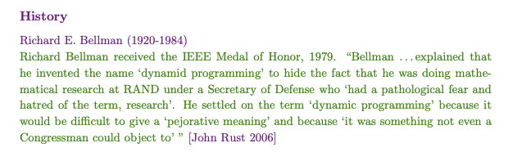
Dynamic Programming

Slide 6
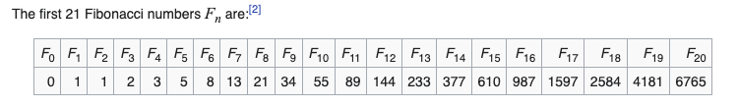
Dynamic Programming – Fibonacci Number
F₁ = F₂ = 1
F_{n} = F_{n-1} + F_{n-2}

Slide 7
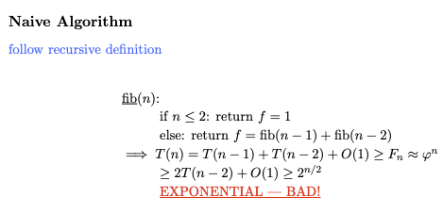
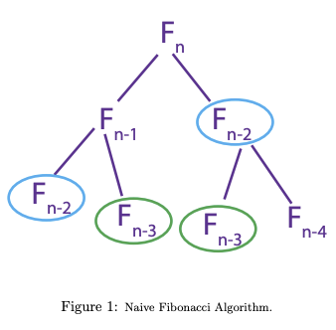
Dynamic Programming – Naive Algorithm
F₅
F₄
F₃
F₃
F₂
F₂
F₁
F₂
F₁
F₁
F₀
F₁
F₀
F₁
F₀

Slide 8
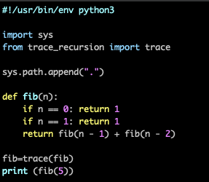
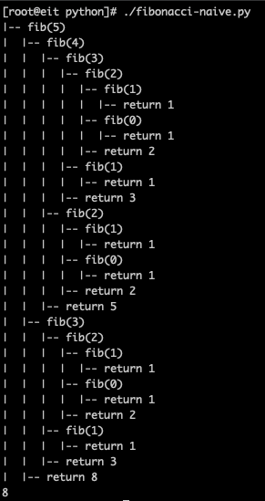
Dynamic Programming – Naive Algorithm

Slide 9
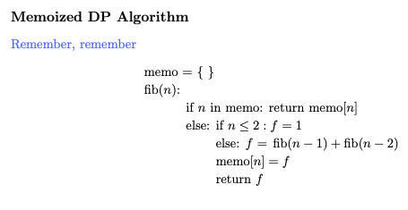
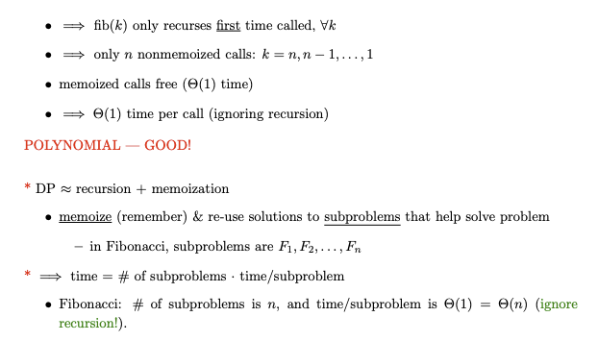
Dynamic Programming – Memorized DP Algorithm
memo[n]
memo[n]
memo[n]

Slide 10
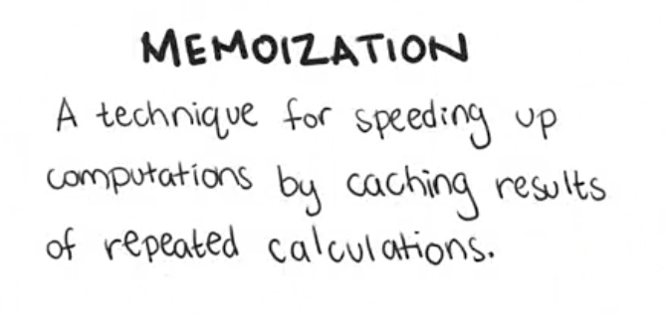
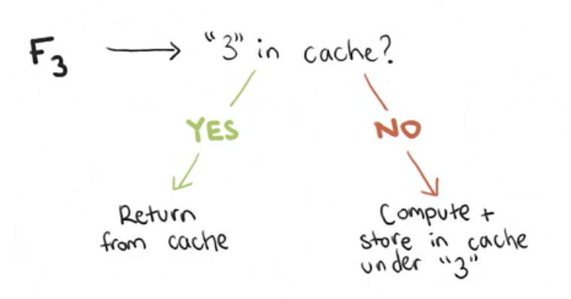
Dynamic Programming – Memorized DP Algorithm
F₅
F₄
F₃
F₃
F₂
F₂
F₁
F₂
F₁
F₁
F₀
F₁
F₀
F₁
F₀

Slide 11
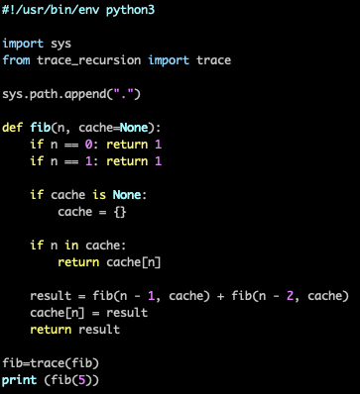
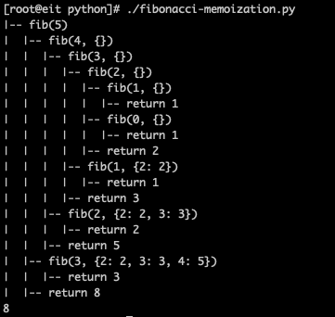
Dynamic Programming – Memorized DP Algorithm

Slide 12
Dynamic Programming – Naive vs Memorized

Slide 13
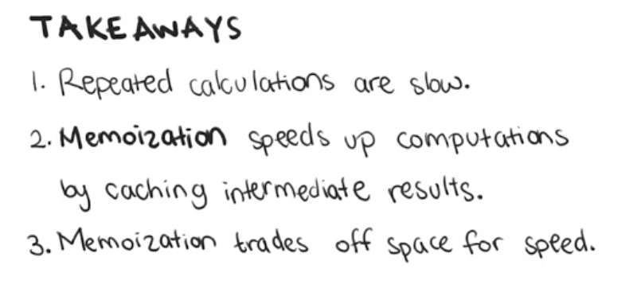
Dynamic Programming – Memorized

Slide 14
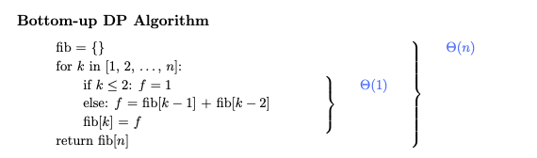
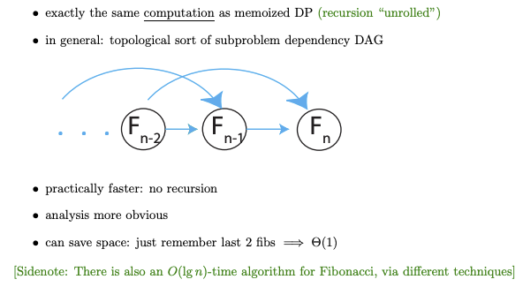
Dynamic Programming – Bottom-up DP Algorithm

Slide 15
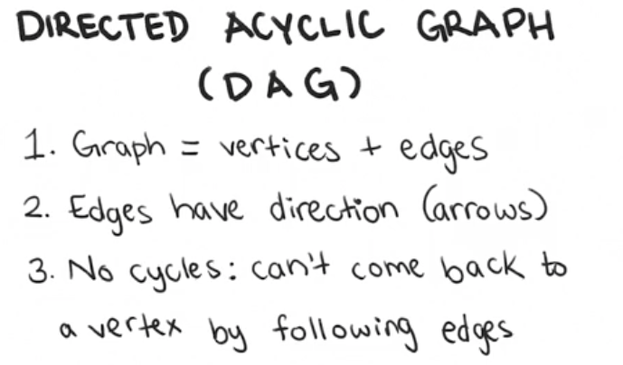
Dynamic Programming – Bottom-up DP Algorithm
F₀
F₁
F₂
F₀
F₁
F₂
F₃
F₀
F₁
F₂
F₃
F₄
F₀
F₁
F₂
F₃
F₄
F₅
F₀
F₁
F₂
F₃
F₄
F₅

Slide 16
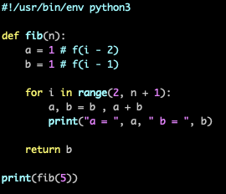
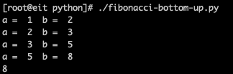
Dynamic Programming – Bottom-up DP Algorithm

Slide 17
Dynamic Programming

Slide 18
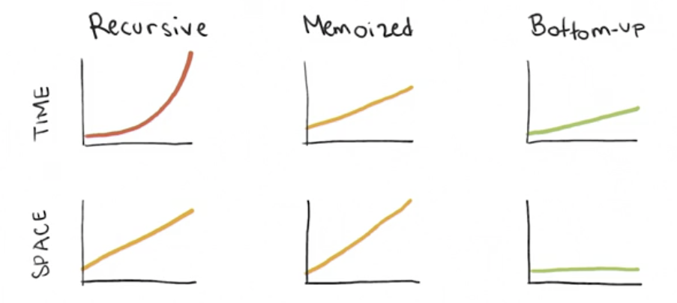
Dynamic Programming

Slide 19
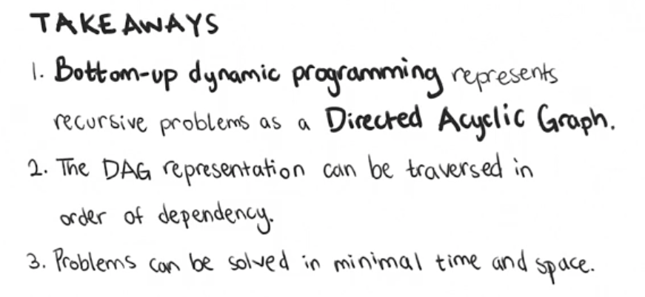
Dynamic Programming

Slide 20
Q & A

